Slide 1
THERE GOES THE NEIGHBOURHOOD
East London 2004-2012

Slide 3
I’ve worked here for a couple of years , since the campus was opened, in fact. I enjoy it but the hours are long and the pay is not good. I am glad to see so many of our young people coming here, getting ahead in life. I didn’t have the opportunities myself but I’d like my own daughter to come here one day. The only thing I wonder about is how come there are not so many white students here. Is it because they don’t think UEL is good enough for them? Porter and Newham resident

Slide 4
Business is bringing changes to areas which have long been run down. It is bringing hope to minority ethnic communities who for too long have been excluded from the enterprise culture even though they have a special aptitude for it. We used to have sportsmen and women as our folk heroes and role models. Nowadays it is entrepreneurs , people working in the creative industries, who make good money but empower the community at the same time. Local entrepreneur

Slide 5
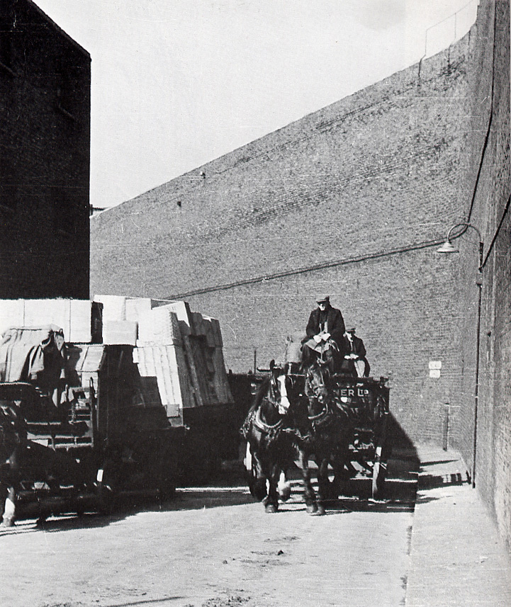
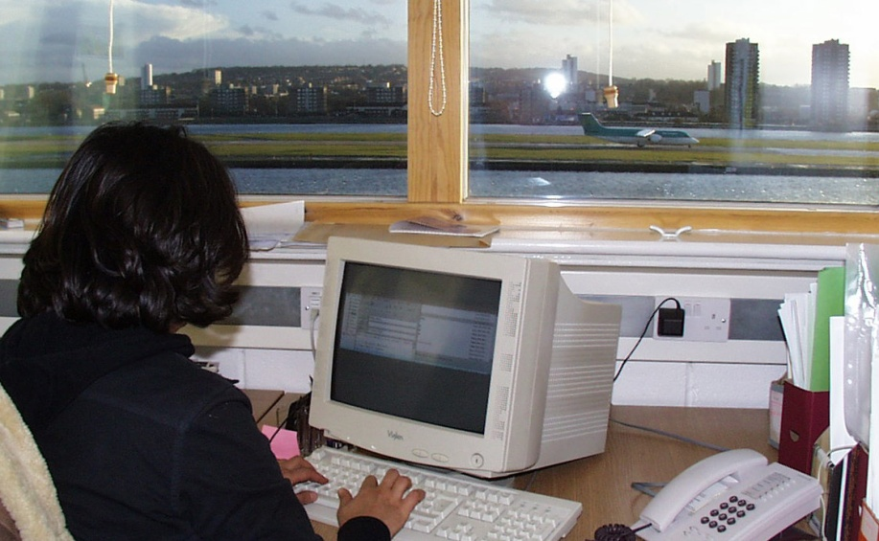
When the walls (dont) come tumbling down

Slide 6
There goes the Neighbourhood
I look out over there sometimes and I see Aer Lingus going out and I wish I was on it. They say the airport is dirty but we had all that dirt from the ships as well. I think people who had lived here , had grown up with the noise, because you used to have the factories sound their sirens in the morning, then again at lunch and when it was time to knock off. The same with docks , you got used to it, when the ships were going out they would sound their funnel and then the trains would shunt and that would go on all night. And at least we’re not surrounded by these terrible high walls, that shut out the light and overshadowed our lives, cutting off our world as women and children from the menfolk – Silvertown Pensioner
Phil Cohen

Slide 7
This airport and round here it is all buildings and no shops. No butchers, we used to have a bakers down the road. We used to have a co-op and now got houses built on it. I'm fortunate I can get out and go on the buses but In think of other people that can't . The airport and all that, it isn't fair . Long standing resident

Slide 8
Since I've moved here I've not had much to do with the locals - they keep themselves to themselves, though we are thinking of sending our daughter to the local primary, so I suppose it might change. Some of my friends think I'm mad living out here, but I regard myself as a pioneer in helping make over the area, making it more multicultural. We do encounter some problems- I think the white working class here are envious of successful black professionals like myself, but what else is new ? And of course it is convenient for the airport - that's how I got to know the area in the first place, and its ten minutes into work. Incoming resident

Slide 9
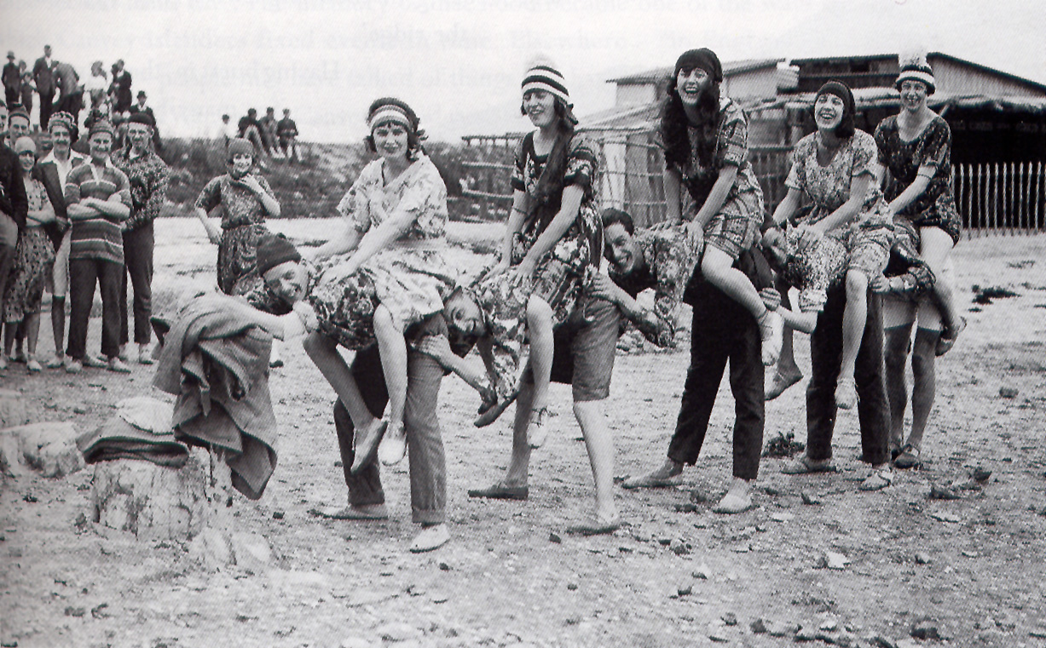
Whatever Happened to the Dagenham Girl pipers?

Slide 10
Once upon a time the streets in this area were crowded with people coming to and from work . The river economy used to link the communities of the North and South banks , but since the docks have closed , people have kind of shrunk into themselves. Dagenham is becoming a ghost town , everyone is leaving to go down river, Canvey Island, Southend and all points east. The East End isn’t Bethnal Green or even Barking any more , its Brightlingsea. People move on.Long term resident

Slide 11
Dagenham: The Post Fordist Factory

Slide 12
None of us live here anymore

Slide 13
Big Bang Localism 1

Slide 14
History will call it the Decent Society, a new social order for the Age of Achievement for Britain. We will respect family life, develop it and encourage it in any way we can because strong families are the foundation of strong communities. We offer a common vision and sense of belonging for all communities. The diversity of peoples different backgrounds and circumstances are appreciated and positively valued; those from different backgrounds have similar life opportunities and strong and positive relationships are developed between people from different backgrounds in the workplace, in schools and in neighbourhoods Tony Blair 2004.

Slide 15
We call it the Big Society because it is about ordinary people taking responsible for their own communities, take care of one another, respecting each others differences, it is about a new localism, a new sense that what happens on our streets and housing estates is decided by the people who live there. David Cameron 2014

Slide 16
Proxemics

Slide 17
The old face to face communities of place are finished. At best they are little more than ghettoised clusters of people left behind in the transition to the new economy , at the worst they are the seedbed of reactionary NIMBYism. The new communities are based on affinity of interests not affiliation , they are located in a global mediascape where flows of information maximise connexivity . We are talking virtual neighbourhoods, neighbourhoods that stretch around the world Demos Think Tank report.

Slide 18
The whole world in our hands?

Slide 19
I can surf the internet, I can phone my cousin in Bombay on my mobile phone , I can send emails to my relatives around the world but I am terrified to go outside my front door , to go down the street to get a newspaper from the corner shop in case I run into the racist thugs who live opposite who are making my life a hell with their insults Asian Resident in Newham

Slide 20
The old face to face communities of place are finished. At best they are little more than ghettoised clusters of people left behind in the transition to the new economy , at the worst they are the seedbed of reactionary NIMBYism. The new communities are based on affinity of interests not affiliation , they are located in a global mediascape where flows of information maximise connexivity . We are talking virtual neighbourhoods, neighbourhoods that stretch around the world . Demos Think Tank Report

Slide 21
The Virtual Panopticon

Slide 22
The Neighbourhood Information Management System (NIMS ) has been developed with the objectives of streamlining strategic decision making, ensuring community involvement, and providing effective monitoring of partners policies... NIMS is a web based interface created by building upon the existing MapInfo technology. NIMS has the ability to store public and confidential data from various agencies to allow easy analysis via mapping tabling and charts. It enables us to drill down into the neighbourhood with much greater precision than before, and to develop a more refined and fine grained scalar geography , moving from the Census Enumeration District, to post code analysis right down to individual rooftop level.
Currently, participants of the NIMS Project include the Metropolitan Police, London Fire Brigade, National Health Service, Newham Primary Care Trust, and others.

Slide 23
Lonely Crowd or Flash Mob?

Slide 24
There is nothing we fear more than the touch of the unknown. We always want to see what is reaching towards us to recognise or at least classify it. All the distances which we create around ourselves are dictated by this fear. This repugnance to being touched accompanies us when we go about amongst people - the way we move in a busy street, in trains and buses . It is only in a crowd that we become free of this fear- for here the fear of being touched changes into its opposite . The crowd we need is the dense crowd in which body is pressed to body; a crowd whose psychological constitution is also dense so we no longer notice or care who it is that presses against us . As soon as we have surrendered ourselves to such a crowd we cease to fears the others touch. Ideally all are equal here , no distinction count , not even that of sex .Suddenly it is as if everything were happening in one and the same body :Elias Canetti Crowds and Power.

Slide 25
Holy Communitas!

Slide 26
In the commonwealth I would by contraries
Execute all things; for no kind of traffic
Would I admit, no name of magistrate,
Letters should not be known; riches, poverty
And use of service contract, succession
None
All things in common nature should produce
Without sweat or endeavour; need of any engine
Would I not have; but nature should bring forth
Of its own kind all abundance
To feed my innocent people
I would with such perfection govern , sir, to excel the golden age
-Gonzalo : Tempest

Slide 27
There goes the neighbourhood

Slide 28
Whitbread award winning author Jeanette Winterson today launched her latest venture – a delicatessen and fruiterers on the ground floor of her house in Spitalfiels. ‘ I wanted to do something people in the neighbourhood could use , where I could sell things I wanted to buy myself and take my shopping upstairs . She has kept the name of the original shop ‘Verde’s’ after an Italian importer of oranges who opened a fruit and veg business here in the 1850’s. ‘They were probably a bunch of ruffians but its better to keep their name than have some American coffee house franchise or awful sandwich shop’, Winterson said.
The opening party was on Thursday night. We had mulled wine and hot chestnuts . Ruth Rendell was here. Fiona Shaw and of course Tracey Emin. She lives just down the road – everyone seems to live around here now. But when I first moved in 1994 tramps used to light their bonfires with jerry cans of petrol. My house had been on the market for 15 years – I am not saying how much I paid for it – but a small amount – in a Securicor box.
Winterson will be making only guest appearances at the counter . She has hired former chef Harvey Cabannis to keep shop. ‘I was a head chef and now I’m a shopkeeper’ he said, ‘but aren’t the English supposed to be a nation of shopkeepers?’

